Slide 1

TRANSACTION TEAM
Using AI at Work
A few things to keep in mind about the AI chat tools we use day to day.

Slide 2


What we'll cover
01
A few terms first
05
Some examples of how to use AI
02
Two examples of AI at work
06
Examples of what not to share
03
AI tools and differences according to accounts
07
Why AI makes things up
04
Before you automate: is AI in the loop?
08
Who owns what it writes?
2

Slide 3
A few terms first, so we're all on the same page
1
AI model (or “LLM”)
2
Prompt
The engine behind the AI chat tools out there. It's been trained on a huge pile of text to guess a good next answer. It doesn't know things the way a person does.
Just what you type in: the question or instruction you give it. A better prompt gets you a better answer, which we'll come back to.
3
Training data
4
AI agent
Everything a model has learned from. On some accounts, what you type today can end up shaping tomorrow's version of the model, more on that shortly.
A tool built on top of a model that can actually go do something (search, calculate, pull a file) instead of just chatting back at you.
AI hallucination
When it states something false with total confidence: a rule, a source that simply doesn't exist. This is the one to remember: always check anything factual before you rely on it.
5
3

Slide 4


Two examples of AI at work
Not the only kinds out there, but a useful line to know.
1
Our own AI agent
2
An outside AI tool
Something the company sets up and controls itself. It might run on the same kind of model as any public AI chat tool under the hood, but it lives inside our own systems, with our own rules about what it can see and where the data goes.
Any AI chat tool you've signed up for yourself through a browser or an app. Genuinely useful. But the moment you're in it, you're a guest inside someone else's product, on their terms.
Examples: an internal assistant IT built for us, a tool wired directly into our own systems and data.
Examples: a public AI chatbot on your own login, an AI app on your phone, any free browser extension that “adds AI” to something.
Same kind of tool. Completely different rules about what happens to what you type.
4

Slide 5
AI tools and differences according to accounts
Free, paid personal, and business accounts are three different contracts, not three price points on the same thing.
 | Personal (Free) | Personal (Paid) | Business / Enterprise
Trains the model on what you type? | On by default, opt out yourself | On by default, opt out yourself | No, by default
Who can actually see it | The provider | The provider | Us, provider access is contractually limited
Data deletion on request | Rarely | Sometimes | Yes, configurable
Can the company manage the account? | No | No | Admin controls, company sign-in
A paid personal subscription buys you a faster, better tool. It doesn't buy you privacy.
Disclaimer: data policies like these change constantly and vary by provider, so check the tool's own current
data policy and go into its Data Controls yourself. Don't assume the default is doing what you want.
5

Slide 6
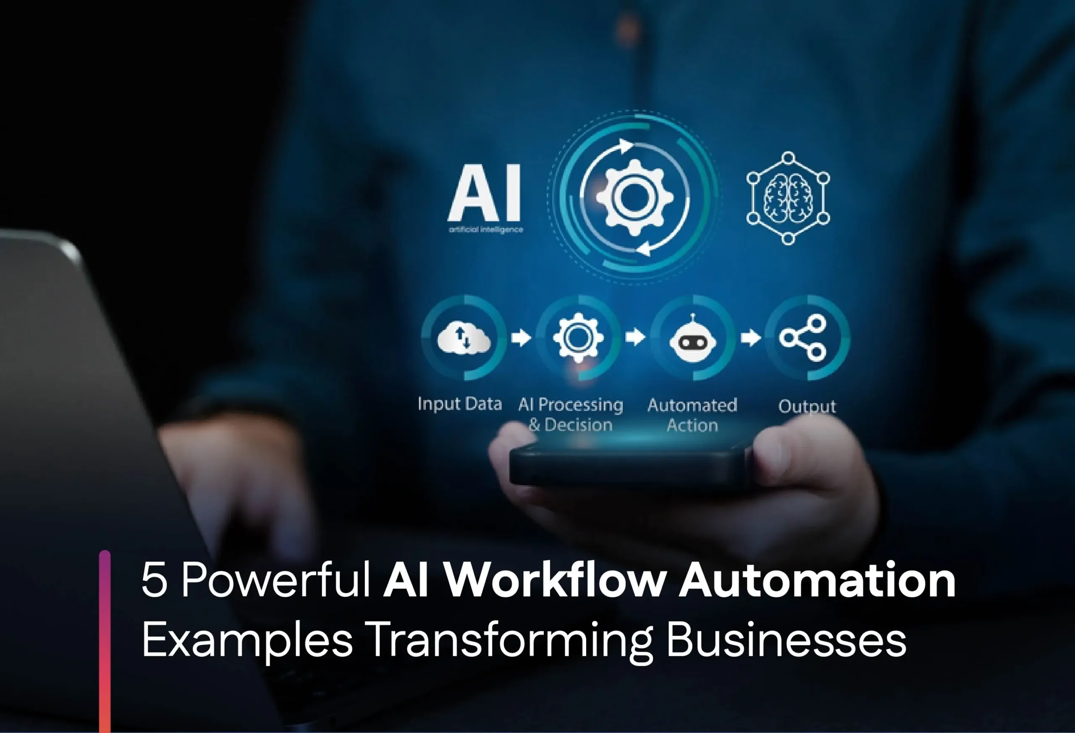

Before you automate: is AI actually in the loop?
Not every automation needs what's on the last page. The ones with an AI step do.
1
No AI involved
A scheduled export, a template macro, a straightforward rules engine moving data from one place to another. Normal build, test, and sign-off process applies, same as any other process change.
2
AI is one of the steps
If any step reads, summarises, decides, or drafts using an AI model, it inherits the same account rules from the last page. Test it on made-up data first, and write down what each piece of that made-up data stands in for.
6

Slide 7

Some examples of how to use AI
None of this needs code, and none of it needs a new system.
1
2
3
Explaining an issue
Checking your writing
Explaining new things
Describe what's going wrong in plain words and ask what usually causes that pattern.
Ask it to find the gaps or the unclear bit before you send an email or a note.
Market terms, a system, contract language: explained in plain English, no client data needed.
7

Slide 8

Examples of what not to share
NEVER PASTE THIS
Client: Jane Doe, Acme Holdings Ltd
Account: 88-4471-02
Amount: EUR 41,220, due 14 Mar
Login: j.doe / ••••••••
Names a person, a company, an account number, an amount, and a login. Once it's sent, it can't be pulled back.
Take out the who, keep the what. Names, account numbers and exact amounts come out; the actual problem stays in.
8

Slide 9

Why AI makes things up (and how to reduce it)
This matters most with an outside tool: there's no one behind it checking your specific answer.
WHY IT HAPPENS
HOW TO REDUCE IT: PROMPT FOR IT
1
No access to our systems, it only knows what you tell it.
Try asking it this:
It has a cutoff date, a new rule or updated circular might not be in there yet.
“Always tell me where this comes from. If you don't have a real source, or you're not sure, say so instead of guessing.”
2
3
It's built to sound fluent, not to flag doubt: the tone is the same whether it's sure or just making something up.
4
Disagreeing with it often makes it agree with you, which isn't the same as you being right.
9

Slide 10

Who owns what it writes?
Ownership of AI-written material is still an open legal question, treat it that way.
THE SHORT VERSION
HOW TO STAY COVERED
Courts have been ruling that something purely AI-written isn't protected by copyright at all, only the parts where a person actually made the creative decisions. Typing a good prompt, or picking your favorite draft out of a few, doesn't count as authorship on its own.
1
Edit it, don't just copy it.
Real changes and choices are what make something actually yours.
2
Keep a record.
Note what was AI-drafted and what a person changed, especially for anything client-facing.
3
Don't publish it as-is.
Not under the company's name, for anything that matters legally or commercially.
In practice: a report or client note that's mostly untouched AI output may not be something the company can fully claim as its own work, or stop someone else from copying.
Ask when it's not obvious.
4
Check with Legal or Compliance before your name, or the company's, goes on AI-written material.
10

Slide 11

If you were wondering, yes, this presentation was made with AI help.

